Slide 1
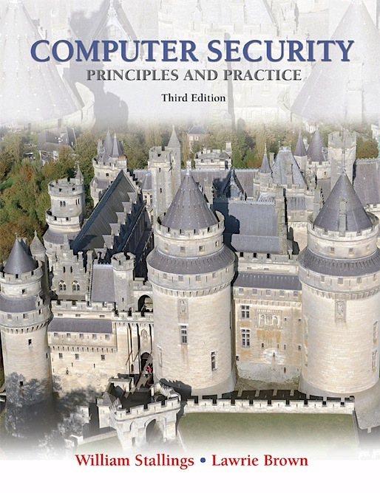
Lecture 3 Access Control Models
modified from slides of Lawrie Brown
Notes:
In most computer security contexts, user authentication is the fundamental building
block and the primary line of defense. User authentication is the basis for most
types of access control and for user accountability.

Slide 2

Access Control
Access control defines a number of protection schemes that prevent unauthorized access to a computer, network, database, or other data resources.
The concepts of AAA involve three security services:
Authentication,
Authorization and
Accounting.
Notes:
RFC 2828 defines user authentication as follows:
The process of verifying an identity claimed by or for a system entity.

Slide 3
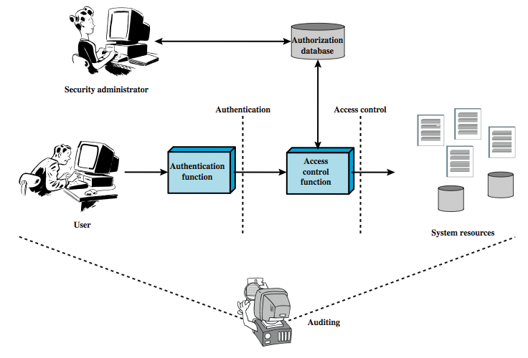
Access Control Principles
Granting of a right or permission to an entity to access a system resource.
Verification that the credentials of a user or an entity are valid.
An independent review and examination of system records and activities
Notes:
Figure 4.1 shows a broader context of access control. In addition to access
control, this context involves the following entities and functions:
• Authentication: Verification that the credentials of a user or other system
entity are valid.
Authorization: The granting of a right or permission to a system entity to
access a system resource. This function determines who is trusted for a given
purpose.
• Audit: An independent review and examination of system records and activities
in order to test for adequacy of system controls, to ensure compliance with
established policy and operational procedures, to detect breaches in security,
and to recommend any indicated changes in control, policy and procedures.
An access control mechanism mediates between a user (or a process executing
on behalf of a user) and system resources, such as applications, operating systems,
firewalls, routers, files, and databases. The system must first authenticate an entity
seeking access. Typically, the authentication function determines whether the user
is permitted to access the system at all. Then the access control function determines
if the specific requested access by this user is permitted. A security administrator
maintains an authorization database that specifies what type of access to which
resources is allowed for this user. The access control function consults this database
to determine whether to grant access. An auditing function monitors and keeps a
record of user accesses to system resources.
In the simple model of Figure 4.1, the access control function is shown as
a single logical module. In practice, a number of components may cooperatively
share the access control function. All operating systems have at least a rudimentary,
and in many cases a quite robust, access control component. Add-on security
packages can supplement the native access control capabilities of the OS. Particular
applications or utilities, such as a database management system, also incorporate
access control functions. External devices, such as firewalls, can also provide access
control services.

Slide 4
AAA- Authentication
the four means of authenticating user identity are based on:
something the individual knows
password, PIN, answers to prearranged questions
something the individual possesses (token)
smartcard, electronic keycard, physical key
something the individual is (static biometrics)
fingerprint, retina, face
something the individual does (dynamic biometrics)
voice pattern, handwriting, typing rhythm
Notes:
There are four general means of authenticating a user's identity, which can be used alone or in combination:
• Something the individual knows: Examples includes a password, a personal identification number (PIN), or answers to a prearranged set of questions.
• Something the individual possesses: Examples include electronic keycards, smart cards, and physical keys. This type of authenticator is referred to as a token.
• Something the individual is (static biometrics): Examples include recognition by fingerprint, retina, and face.
• Something the individual does (dynamic biometrics): Examples include recognition by voice pattern, handwriting characteristics, and typing rhythm.
All of these methods, properly implemented and used, can provide secure user authentication. However, each method has problems. An adversary may be able to guess or steal a password. Similarly, an adversary may be able to forge or steal a token. A user may forget a password or lose a token. Further, there is a significant administrative overhead for managing password and token information on systems and securing such information on systems. With respect to biometric authenticators, there are a variety of problems, including dealing with false positives and false negatives, user acceptance, cost, and convenience.

Slide 5
AAA-Authorization, Accounting
Authorization services determine which resources users can access, along with the operations that users can perform, Some systems accomplish this by using an access control list, or an ACL (Access Control List)
Accounting keeps track of what users do, including what they access, the amount of time they access resources, and any changes made. For example, a bank keeps track of each customer account.
Notes:
RFC 2828 defines user authentication as follows:
The process of verifying an identity claimed by or for a system entity.

Slide 6
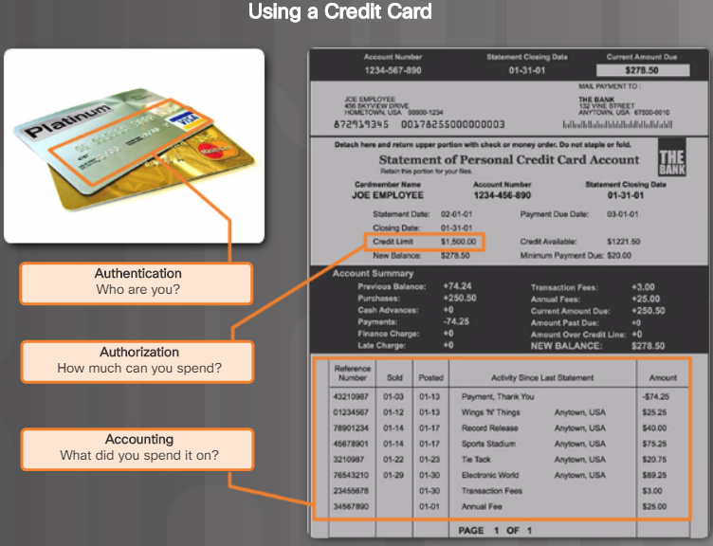
AAA Example
Notes:
RFC 2828 defines user authentication as follows:
The process of verifying an identity claimed by or for a system entity.

Slide 7
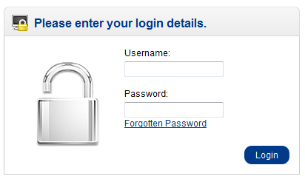
Authentication
Password authentication
The most popular authentication method, it uses username or user ID to identify each user. The user then creates his own password.
Notes:
RFC 2828 defines user authentication as follows:
The process of verifying an identity claimed by or for a system entity.

Slide 8
Authentication Password Vulnerabilities
offline dictionary attack
popular password attack
workstation hijacking
exploiting multiple password use
specific account attack
password guessing against single user
exploiting user mistakes
electronic monitoring
Notes:
In this subsection, we outline the main forms of attack against password-based
authentication and briefly outline a countermeasure strategy. The remainder of
Section 3.2 goes into more detail on the key countermeasures.
We can identify the following attack strategies:
• Offline dictionary attack: Typically, strong access controls are used to protect
the system’s password file. However, experience shows that determined
hackers can frequently bypass such controls and gain access to the file. The
attacker obtains the system password file and compares the password hashes
against hashes of commonly used passwords. If a match is found, the attacker
can gain access by that ID/password combination.
• Specific account attack: The attacker targets a specific account and submits
password guesses until the correct password is discovered.
• Popular password attack: A variation of the preceding attack is to use a popular
password and try it against a wide range of user IDs. A user’s tendency
is to choose a password that is easily remembered; this unfortunately makes
the password easy to guess.
• Password guessing against single user: The attacker attempts to gain knowledge
about the account holder and system password policies and uses that
knowledge to guess the password.
• Workstation hijacking; The attacker waits until a logged-in workstation is
unattended.
• Exploiting user mistakes: If the system assigns a password, then the user is
more likely to write it down because it is difficult to remember. This situation
creates the potential for an adversary to read the written password. A user
may intentionally share a password, to enable a colleague to share files, for
example. Also, attackers are frequently successful in obtaining passwords by
using social engineering tactics that trick the user or an account manager into
revealing a password. Many computer systems are shipped with preconfigured
passwords for system administrators. Unless these preconfigured passwords
are changed, they are easily guessed.
• Exploiting multiple password use. Attacks can also become much more
effective or damaging if different network devices share the same or a similar
password for a given user.
• Electronic monitoring: If a password is communicated across a network to
log on to a remote system, it is vulnerable to eavesdropping. Simple encryption
will not fix this problem, because the encrypted password is, in effect, the
password and can be observed and reused by an adversary

Slide 9
Authentication Password Vulnerabilities Countermeasures
controls to prevent unauthorized access to password file
intrusion detection measures
rapid reissuance of compromised passwords
account lockout mechanisms
policies to inhibit users from selecting common passwords
training in and enforcement of password policies
automatic workstation logout
policies against similar passwords on network devices
Notes:
Typically, a system that uses password-based authentication maintains a password
file indexed by user ID. One technique that is typically used is to store not the user’s
password but a one-way hash function of the password, as described subsequently.
• Offline dictionary attack: Countermeasures include
controls to prevent unauthorized access to the password file, intrusion detection
measures to identify a compromise, and rapid reissuance of passwords
should the password file be compromised.
• Specific account attack: The standard countermeasure
is an account lockout mechanism, which locks out access to the
account after a number of failed login attempts. Typical practice is no more
than five access attempts.
• Popular password attack: Countermeasures include policies to inhibit the
selection by users of common passwords and scanning the IP addresses of
authentication requests and client cookies for submission patterns.
• Password guessing against single user: Countermeasures include training in and
enforcement of password policies that make passwords difficult to guess.
Such policies address the secrecy, minimum length of the password, character
set, prohibition against using well-known user identifiers, and length of time
before the password must be changed.
• Workstation hijacking; The standard countermeasure is automatically logging the workstation
out after a period of inactivity. Intrusion detection schemes can be
used to detect changes in user behavior.
• Exploiting user mistakes: Countermeasures include user training,
intrusion detection, and simpler passwords combined with another authentication
mechanism.
• Exploiting multiple password use. Countermeasures include a policy that forbids the
same or similar password on particular network devices.
• Electronic monitoring: If a password is communicated across a network to
log on to a remote system, it is vulnerable to eavesdropping. Simple encryption
will not fix this problem, because the encrypted password is, in effect, the
password and can be observed and reused by an adversary

Slide 10
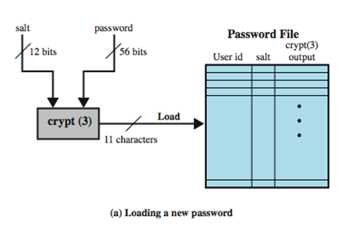
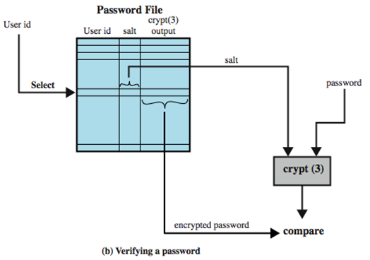
Use of Hashed Passwords
prevents duplicate passwords from being visible in the password file.
greatly increases the difficulty of offline dictionary attacks. For a salt of length b bits, the number of possible passwords is increased by a factor of 2^{b}.
becomes nearly impossible to find out whether a person with passwords on two or more systems has used the same password on all of them.
Notes:
A widely used password security technique is the use of hashed passwords and a salt
value. This scheme is found on virtually all UNIX variants as well as on a number
of other operating systems. The following procedure is employed (Figure 3.1a). To
load a new password into the system, the user selects or is assigned a password. This
password is combined with a fixed-length salt value [MORR79]. In older implementations,
this value is related to the time at which the password is assigned to the user.
Newer implementations use a pseudorandom or random number. The password
and salt serve as inputs to a hashing algorithm to produce a fixed-length hash code.
The hash algorithm is designed to be slow to execute to thwart attacks. The hashed
password is then stored, together with a plaintext copy of the salt, in the password
file for the corresponding user ID. The hashed-password method has been shown to
be secure against a variety of cryptanalytic attacks [WAGN00].
When a user attempts to log on to a UNIX system, the user provides an ID
and a password (Figure 3.1b). The operating system uses the ID to index into the
password file and retrieve the plaintext salt and the encrypted password. The salt
and user-supplied password are used as input to the encryption routine. If the result
matches the stored value, the password is accepted.
The salt serves three purposes:
• It prevents duplicate passwords from being visible in the password file. Even if
two users choose the same password, those passwords will be assigned different
salt values. Hence, the hashed passwords of the two users will differ.
• It greatly increases the difficulty of offline dictionary attacks. For a salt of
length b bits, the number of possible passwords is increased by a factor of 2b,
increasing the difficulty of guessing a password in a dictionary attack.
• It becomes nearly impossible to find out whether a person with passwords on
two or more systems has used the same password on all of them.
To see the second point, consider the way that an offline dictionary attack
would work. The attacker obtains a copy of the password file. Suppose first that
the salt is not used. The attacker’s goal is to guess a single password. To that end,
the attacker submits a large number of likely passwords to the hashing function.
If any of the guesses matches one of the hashes in the file, then the attacker
has found a password that is in the file. But faced with the UNIX scheme, the
attacker must take each guess and submit it to the hash function once for each
salt value in the dictionary file, multiplying the number of guesses that must be
checked.
There are two threats to the UNIX password scheme. First, a user can gain
access on a machine using a guest account or by some other means and then run a
password guessing program, called a password cracker, on that machine. The attacker
should be able to check many thousands of possible passwords with little resource
consumption. In addition, if an opponent is able to obtain a copy of the password
file, then a cracker program can be run on another machine at leisure. This enables
the opponent to run through millions of possible passwords in a reasonable period.

Slide 11
Authentication Password Cracking
dictionary attacks
develop a large dictionary of possible passwords and try each against the password file
each password must be hashed using each salt value and then compared to stored hash values
rainbow table attacks
pre-compute tables of hash values for all salts
a mammoth table of hash values
can be countered by using a sufficiently large salt value and a sufficiently large hash length
Notes:
The traditional approach to password guessing,
or password cracking as it is called, is to develop a large dictionary of possible
passwords and to try each of these against the password file. This means that
each password must be hashed using each salt value in the password file and then
compared to stored hash values. If no match is found, then the cracking program
tries variations on all the words in its dictionary of likely passwords. Such variations
include backward spelling of words, additional numbers or special characters, or
sequence of characters,
An alternative is to trade off space for time by precomputing potential hash
values. In this approach the attacker generates a large dictionary of possible passwords.
For each password, the attacker generates the hash values associated with
each possible salt value. The result is a mammoth table of hash values known as a
rainbow table. For example, [OECH03] showed that using 1.4 GB of data, he could
crack 99.9% of all alphanumeric Windows password hashes in 13.8 seconds. This
approach can be countered by using a sufficiently large salt value and a sufficiently
large hash length. Both the FreeBSD and OpenBSD approaches should be secure
from this attack for the foreseeable future.

Slide 12
Password File Access Control
can block offline guessing attacks by denying access to encrypted passwords
make available only to privileged users
vulnerabilities
weakness in the OS that allows access to the file
accident with permissions making it readable
users with same password on other systems
access from backup media
sniff passwords in network traffic
shadow password file
a separate file from the user IDs where the hashed passwords are kept
Notes:
One way to thwart a password attack is to deny the opponent access to the password
file. If the hashed password portion of the file is accessible only by a privileged user,
then the opponent cannot read it without already knowing the password of a privileged
user. Often, the hashed passwords are kept in a separate file from the user
IDs, referred to as a shadow password file. Special attention is paid to making the
shadow password file protected from unauthorized access. Although password file
protection is certainly worthwhile, there remain vulnerabilities:
• Many systems, including most UNIX systems, are susceptible to unanticipated
break-ins. A hacker may be able to exploit a software vulnerability in the
operating system to bypass the access control system long enough to extract
the password file. Alternatively, the hacker may find a weakness in the file
system or database management system that allows access to the file.
• An accident of protection might render the password file readable, thus compromising
all the accounts.
• Some of the users have accounts on other machines in other protection
domains, and they use the same password. Thus, if the passwords could
be read by anyone on one machine, a machine in another location might be
compromised.
• A lack of or weakness in physical security may provide opportunities for a
hacker. Sometimes there is a backup to the password file on an emergency
repair disk or archival disk. Access to this backup enables the attacker to read
the password file. Alternatively, a user may boot from a disk running another
operating system such as Linux and access the file from this OS.
• Instead of capturing the system password file, another approach to collecting
user IDs and passwords is through sniffing network traffic.
Thus, a password protection policy must complement access control measures with
techniques to force users to select passwords that are difficult to guess.

Slide 13
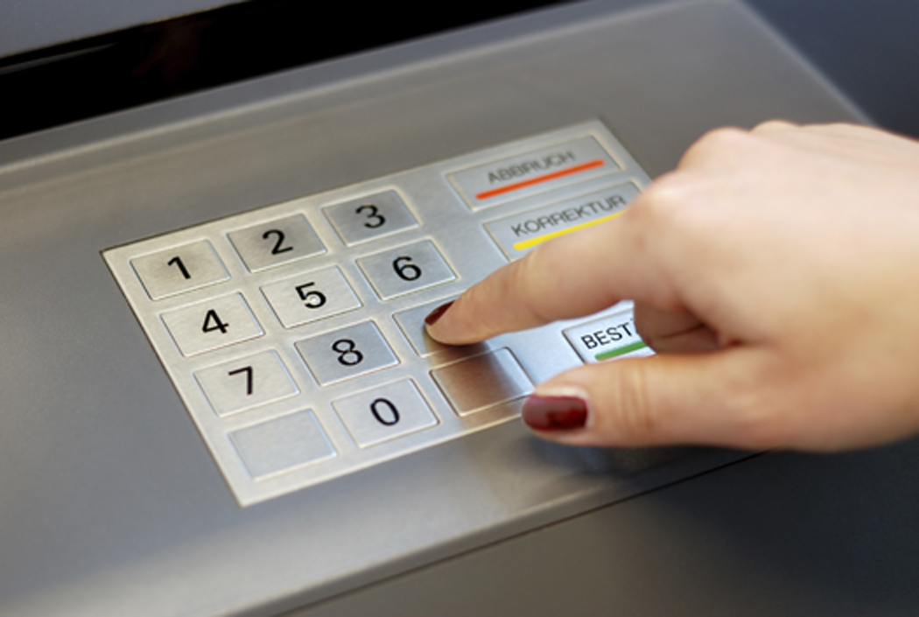
Card Authentication Memory card
can store but do not process data
the most common is the magnetic stripe card
can include an internal electronic memory
can be used alone for physical access
hotel room, ATM
provides significantly greater security when combined with a password or PIN
drawbacks of memory cards include:
requires a special reader
loss of token
user dissatisfaction
Notes:
Memory cards can store but not process data. The most common such card is the
bank card with a magnetic stripe on the back. A magnetic stripe can store only a
simple security code, which can be read (and unfortunately reprogrammed) by
an inexpensive card reader. There are also memory cards that include an internal
electronic memory.
Memory cards can be used alone for physical access, such as a hotel room. For
computer user authentication, such cards are typically used with some form of password
or personal identification number (PIN). A typical application is an automatic
teller machine (ATM).
The memory card, when combined with a PIN or password, provides significantly
greater security than a password alone. An adversary must gain physical
possession of the card (or be able to duplicate it) plus must gain knowledge of the
PIN. Among the potential drawbacks are the following [NIST95]:
• Requires special reader: This increases the cost of using the token and creates
the requirement to maintain the security of the reader’s hardware and software.
• Token loss: A lost token temporarily prevents its owner from gaining system
access. Thus there is an administrative cost in replacing the lost token. In addition,
if the token is found, stolen, or forged, then an adversary now need only
determine the PIN to gain unauthorized access.
• User dissatisfaction: Although users may have no difficulty in accepting the
use of a memory card for ATM access, its use for computer access may be
deemed inconvenient.

Slide 14
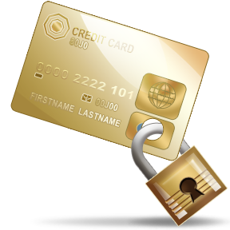
Authentication Smart Cards
Most important category of smart token
Has the appearance of a credit card
Has an electronic interface
May use any of the smart token protocols
Contain:
An entire microprocessor (Processor, Memory, I/O ports)
Typically include three types of memory:
Read-only memory (ROM)
Stores data that does not change during the card’s life
Electrically erasable programmable ROM (EEPROM)
Holds application data and programs
Random access memory (RAM)
Holds temporary data generated when applications are executed
Notes:
For user authentication the most important category of smart token is the
smart card, which has the appearance of a credit card, has an electronic interface,
and may use any of the type of protocols just described. The remainder of this
section discusses smart cards.
A smart card contains within it an entire microprocessor, including processor,
memory, and I/O ports. Some versions incorporate a special co-processing circuit for
cryptographic operation to speed the task of encoding and decoding messages or generating
digital signatures to validate the information transferred. In some cards, the
I/O ports are directly accessible by a compatible reader by means of exposed
electrical contacts. Other cards rely instead on an embedded antenna for wireless communication
with the reader.
A typical smart card includes three types of memory. Read-only memory
(ROM) stores data that does not change during the card’s life, such as the card
number and the cardholder’s name. Electrically erasable programmable ROM
(EEPROM) holds application data and programs, such as the protocols that the
card can execute. It also holds data that may vary with time. For example, in a
telephone card, the EEPROM holds the talk time remaining. Random access
memory (RAM) holds temporary data generated when applications are executed.

Slide 15
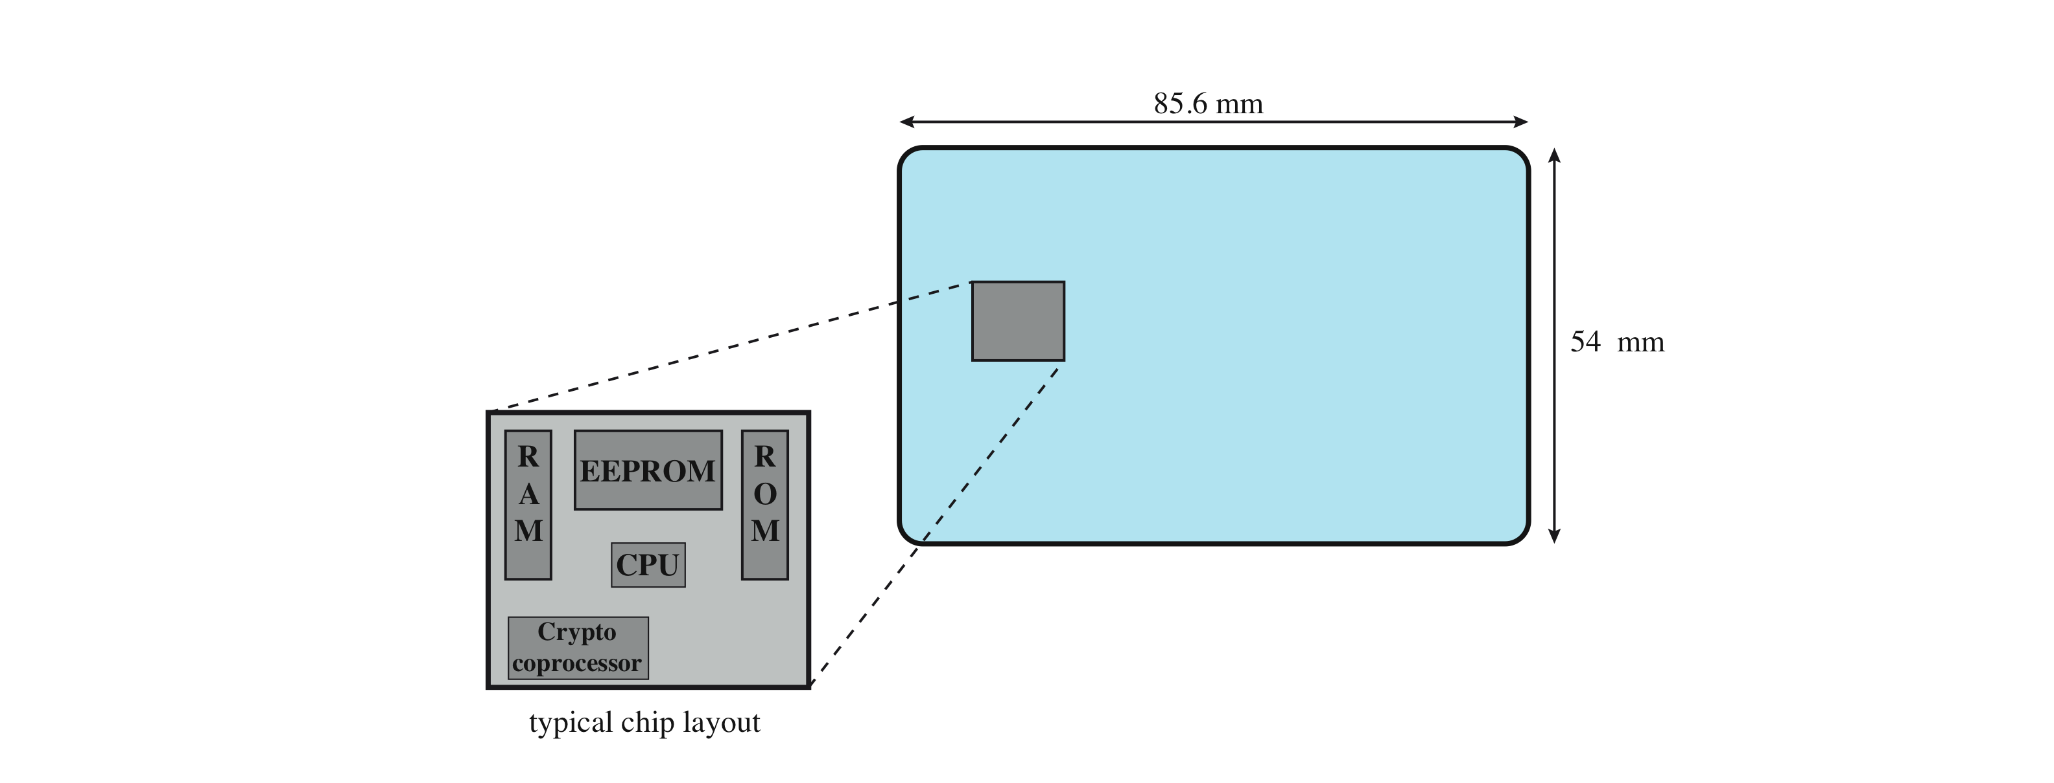
Smart Card Dimensions
The smart card chip is embedded into the
plastic card and is not visible. The dimensions
conform to ISO standard 7816-2.
Notes:
For user authentication to computer, the most important category of smart
token is the smart card, which has the appearance of a credit card, has an electronic
interface, and may use any of the type of protocols just described. The remainder of
this section discusses smart cards.
A smart card contains within it an entire microprocessor, including processor,
memory, and I/O ports (Figure 3.3). Some versions incorporate a special co-processing
circuit for cryptographic operation to speed the task of encoding and decoding messages
or generating digital signatures to validate the information transferred. In some
cards, the I/O ports are directly accessible by a compatible reader by means of exposed
electrical contacts. Other cards rely instead on an embedded antenna for wireless
communication with the reader.
A typical smart card includes three types of memory. Read-only memory
(ROM) stores data that does not change during the card’s life, such as the card
number and the cardholder’s name. Electrically erasable programmable ROM
(EEPROM) holds application data and programs, such as the protocols that the card
can execute. It also holds data that may vary with time. For example, in a telephone
card, the EEPROM holds the talk time remaining. Random access memory (RAM)
holds temporary data generated when applications are executed.

Slide 16

Biometric Authentication
attempts to authenticate an individual based on
unique physical characteristics
pattern recognition
technically complex and expensive
compared to passwords and tokens
physical characteristics used include:
facial characteristics
fingerprints
hand geometry
retinal pattern
iris
signature
voice
Notes:
A biometric authentication system attempts to authenticate an individual based on
his or her unique physical characteristics. These include static characteristics, such
as fingerprints, hand geometry, facial characteristics, and retinal and iris patterns;
and dynamic characteristics, such as voiceprint and signature. In essence, biometrics
is based on pattern recognition. Compared to passwords and tokens, biometric
authentication is both technically complex and expensive. While it is used in a
number of specific applications, biometrics has yet to mature as a standard tool for
user authentication to computer systems.
A number of different types of physical characteristics are either in use or under
study for user authentication. The most common are the following:
• Facial characteristics: Facial characteristics are the most common means
of human-to-human identification; thus it is natural to consider them for
identification by computer. The most common approach is to define characteristics
based on relative location and shape of key facial features, such as
eyes, eyebrows, nose, lips, and chin shape. An alternative approach is to use an
infrared camera to produce a face thermogram that correlates with the underlying
vascular system in the human face.
• Fingerprints: Fingerprints have been used as a means of identification for
centuries, and the process has been systematized and automated particularly
for law enforcement purposes. A fingerprint is the pattern of ridges and
furrows on the surface of the fingertip. Fingerprints are believed to be unique
across the entire human population. In practice, automated fingerprint recognition
and matching system extract a number of features from the fingerprint
for storage as a numerical surrogate for the full fingerprint pattern.
• Hand geometry: Hand geometry systems identify features of the hand,
including shape, and lengths and widths of fingers.
• Retinal pattern: The pattern formed by veins beneath the retinal surface is
unique and therefore suitable for identification. A retinal biometric system
obtains a digital image of the retinal pattern by projecting a low-intensity
beam of visual or infrared light into the eye.
• Iris: Another unique physical characteristic is the detailed structure of the iris.
• Signature: Each individual has a unique style of handwriting and this is
reflected especially in the signature, which is typically a frequently written
sequence. However, multiple signature samples from a single individual will
not be identical. This complicates the task of developing a computer representation
of the signature that can be matched to future samples.
• Voice: Whereas the signature style of an individual reflects not only the unique
physical attributes of the writer but also the writing habit that has developed,
voice patterns are more closely tied to the physical and anatomical characteristics
of the speaker. Nevertheless, there is still a variation from sample to sample over
time from the same speaker, complicating the biometric recognition task.

Slide 17
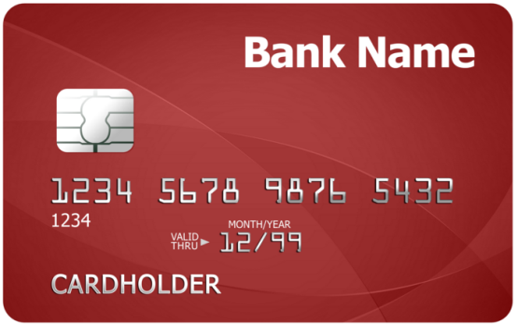
Multi-Factor Authentication
Multi-factor authentication uses at least two methods of verification. A security key fob is a good example. The two factors are something you know, such as a password, and something you have, such as a security key fob
Notes:
A biometric authentication system attempts to authenticate an individual based on
his or her unique physical characteristics. These include static characteristics, such
as fingerprints, hand geometry, facial characteristics, and retinal and iris patterns;
and dynamic characteristics, such as voiceprint and signature. In essence, biometrics
is based on pattern recognition. Compared to passwords and tokens, biometric
authentication is both technically complex and expensive. While it is used in a
number of specific applications, biometrics has yet to mature as a standard tool for
user authentication to computer systems.
A number of different types of physical characteristics are either in use or under
study for user authentication. The most common are the following:
• Facial characteristics: Facial characteristics are the most common means
of human-to-human identification; thus it is natural to consider them for
identification by computer. The most common approach is to define characteristics
based on relative location and shape of key facial features, such as
eyes, eyebrows, nose, lips, and chin shape. An alternative approach is to use an
infrared camera to produce a face thermogram that correlates with the underlying
vascular system in the human face.
• Fingerprints: Fingerprints have been used as a means of identification for
centuries, and the process has been systematized and automated particularly
for law enforcement purposes. A fingerprint is the pattern of ridges and
furrows on the surface of the fingertip. Fingerprints are believed to be unique
across the entire human population. In practice, automated fingerprint recognition
and matching system extract a number of features from the fingerprint
for storage as a numerical surrogate for the full fingerprint pattern.
• Hand geometry: Hand geometry systems identify features of the hand,
including shape, and lengths and widths of fingers.
• Retinal pattern: The pattern formed by veins beneath the retinal surface is
unique and therefore suitable for identification. A retinal biometric system
obtains a digital image of the retinal pattern by projecting a low-intensity
beam of visual or infrared light into the eye.
• Iris: Another unique physical characteristic is the detailed structure of the iris.
• Signature: Each individual has a unique style of handwriting and this is
reflected especially in the signature, which is typically a frequently written
sequence. However, multiple signature samples from a single individual will
not be identical. This complicates the task of developing a computer representation
of the signature that can be matched to future samples.
• Voice: Whereas the signature style of an individual reflects not only the unique
physical attributes of the writer but also the writing habit that has developed,
voice patterns are more closely tied to the physical and anatomical characteristics
of the speaker. Nevertheless, there is still a variation from sample to sample over
time from the same speaker, complicating the biometric recognition task.

Slide 18
Authorization
The prevention of unauthorized use of a resource, including the prevention of use of a resource in an unauthorized manner.
Or Measures that implement and assure security services in a computer system, particularly those that assure access control service
Notes:
RFC 2828 defines user authentication as follows:
The process of verifying an identity claimed by or for a system entity.

Slide 19
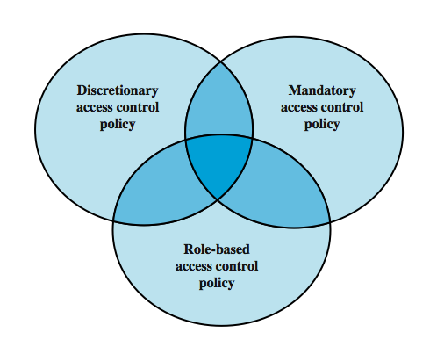
Access Control Policies
dictates
what types of access are permitted,
under what circumstances,
by whom.
based on comparing
security labels with clearances
based on the identity of the requestor and on access rules
based on the roles and their accesses
Notes:
An access control policy, which can be embodied in an authorization database,
dictates what types of access are permitted, under what circumstances, and by
whom. Access control policies are generally grouped into the following categories:
• Discretionary access control (DAC): Controls access based on the identity
of the requestor and on access rules (authorizations) stating what requestors
are (or are not) allowed to do. This policy is termed discretionary because an
entity might have access rights that permit the entity, by its own volition, to
enable another entity to access some resource.
• Mandatory access control (MAC): Controls access based on comparing
security labels (which indicate how sensitive or critical system resources are)
with security clearances (which indicate system entities are eligible to access
certain resources). This policy is termed mandatory because an entity that has
clearance to access a resource may not, just by its own volition, enable another
entity to access that resource.
• Role-based access control (RBAC): Controls access based on the roles that
users have within the system and on rules stating what accesses are allowed to
users in given roles.
DAC is the traditional method of implementing access control, and is examined
in Section 4.3. MAC is a concept that evolved out of requirements for military
information security and is best covered in the context of trusted systems, which we
deal with in Chapter 13. RBAC has become increasingly popular and is covered in
Section 4.5.
These three policies are not mutually exclusive (Figure 4.2). An access control
mechanism can employ two or even all three of these policies to cover different
classes of system resources.

Slide 20
Discretionary Access Control
scheme in which an entity may enable another entity to access some resource
often provided using an access matrix
one dimension consists of identified subjects that may attempt data access to the resources
the other dimension lists the objects that may be accessed
each entry in the matrix indicates the access rights of a particular subject for a particular object
Notes:
As was previously stated, a discretionary access control scheme is one in which an
entity may be granted access rights that permit the entity, by its own volition, to
enable another entity to access some resource. A general approach to DAC, as
exercised by an operating system or a database management system, is that of an
access matrix. The access matrix concept was formulated by Lampson [LAMP69,
LAMP71], and subsequently refined by Graham and Denning [GRAH72, DENN71]
and by Harrison et al. [HARR76].
One dimension of the matrix consists of identified subjects that may attempt
data access to the resources. Typically, this list will consist of individual users or
user groups, although access could be controlled for terminals, network equipment,
hosts, or applications instead of or in addition to users. The other dimension lists
the objects that may be accessed. At the greatest level of detail, objects may be
individual data fields. More aggregate groupings, such as records, files, or even the
entire database, may also be objects in the matrix. Each entry in the matrix indicates
the access rights of a particular subject for a particular object.

Slide 21
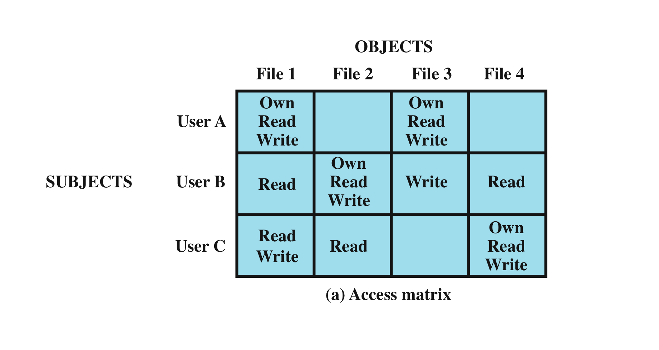
Access Matrix
Notes:
Figure 4.3a, based on a figure in [SAND94], is a simple example of an access
matrix. Thus, user A owns files 1 and 3 and has read and write access rights to those
files. User B has read access rights to file 1, and so on.

Slide 22
Access Control List (ACL)
User B can read, and User C can Own Read and Write. So the object (File 4) has the following sample ACL
File4 >> Deny user A; Allow Read User B,C, Allow Read, Write User C
File1 can be read from User A, User B and User C. It can be read from any user, the following ACL can be used;
File1 >> Allow Read any, Allow Write User A,C, Allow Own User A
Notes:
In practice, an access matrix is usually sparse and is implemented by decomposition
in one of two ways. The matrix may be decomposed by columns, yielding
access control lists (ACLs); see Figure 4.3b. For each object, an ACL lists users and
their permitted access rights. The ACL may contain a default, or public, entry. This
allows users that are not explicitly listed as having special rights to have a default
set of rights. The default set of rights should always follow the rule of least privilege
or read-only access, whichever is applicable. Elements of the list may include
individual users as well as groups of users.
When it is desired to determine which subjects have which access rights to a particular
resource, ACLs are convenient, because each ACL provides the information
for a given resource. However, this data structure is not convenient for determining
the access rights available to a specific user.
Decomposition by rows yields capability tickets (Figure 4.3c). A capability
ticket specifies authorized objects and operations for a particular user. Each user
has a number of tickets and may be authorized to loan or give them to others.
Because tickets may be dispersed around the system, they present a greater security
problem than access control lists. The integrity of the ticket must be protected,
and guaranteed (usually by the operating system). In particular, the ticket must
be unforgettable. One way to accomplish this is to have the operating system hold
all tickets on behalf of users. These tickets would have to be held in a region of
memory inaccessible to users. Another alternative is to include an unforgeable
token in the capability. This could be a large random password, or a cryptographic
message authentication code. This value is verified by the relevant resource whenever
access is requested. This form of capability ticket is appropriate for use in a
distributed environment, when the security of its contents cannot be guaranteed.
The convenient and inconvenient aspects of capability tickets are the opposite
of those for ACLs. It is easy to determine the set of access rights that a given user
has, but more difficult to determine the list of users with specific access rights for a
specific resource.

Slide 23
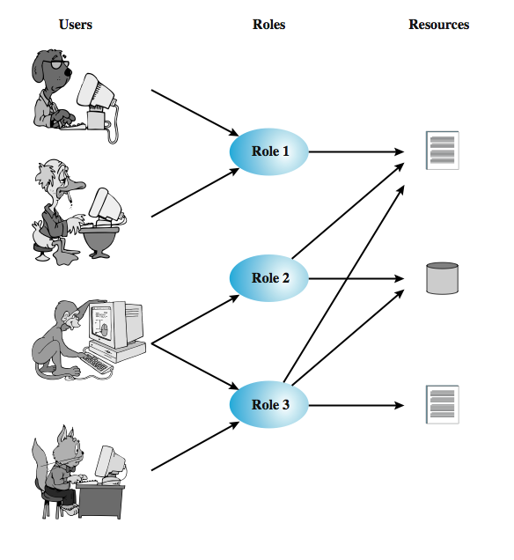
Role-Based Access Control (RBAC)
Notes:
Traditional DAC systems define the access rights of individual users and groups
of users. In contrast, RBAC is based on the roles that users assume in a system
rather than the user’s identity. Typically, RBAC models define a role as a job function
within an organization. RBAC systems assign access rights to roles instead of
individual users. In turn, users are assigned to different roles, either statically or
dynamically, according to their responsibilities.
RBAC now enjoys widespread commercial use and remains an area of active
research. The National Institute of Standards and Technology (NIST) has issued a
standard, Security Requirements for Cryptographic Modules (FIPS PUB 140-2, May
25, 2001), that requires support for access control and administration through roles.
The relationship of users to roles is many to many, as is the relationship of
roles to resources, or system objects (Figure 4.7). The set of users changes, in some
environments frequently, and the assignment of a user to one or more roles may
also be dynamic. The set of roles in the system in most environments is relatively
static, with only occasional additions or deletions. Each role will have specific access
rights to one or more resources. The set of resources and the specific access rights
associated with a particular role are also likely to change infrequently.

Slide 24
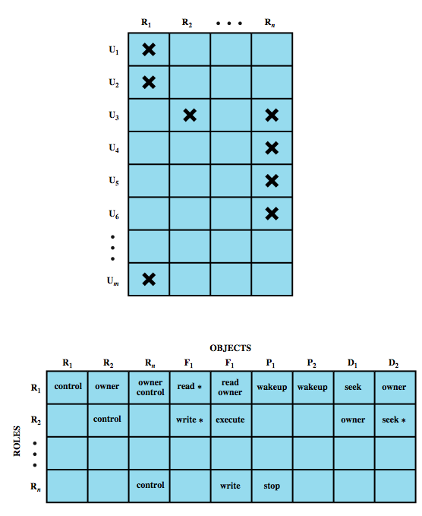
Access Control Matrix
Notes:
We can use the access matrix representation to depict the key elements of an
RBAC system in simple terms, as shown in Figure 4.8. The upper matrix relates
individual users to roles. Typically there are many more users than roles. Each matrix
entry is either blank or marked, the latter indicating that this user is assigned to this
role. Note that a single user may be assigned multiple roles (more than one mark in a
row) and that multiple users may be assigned to a single role (more than one mark in
a column). The lower matrix has the same structure as the DAC access control matrix,
with roles as subjects. Typically, there are few roles and many objects, or resources.
In this matrix the entries are the specific access rights enjoyed by the roles. Note that a
role can be treated as an object, allowing the definition of role hierarchies.
RBAC lends itself to an effective implementation of the principle of least
privilege, referred to in Section 4.1. Each role should contain the minimum set of
access rights needed for that role. A user is assigned to a role that enables him or her
to perform only what is required for that role. Multiple users assigned to the same
role, enjoy the same minimal set of access rights.

Slide 25
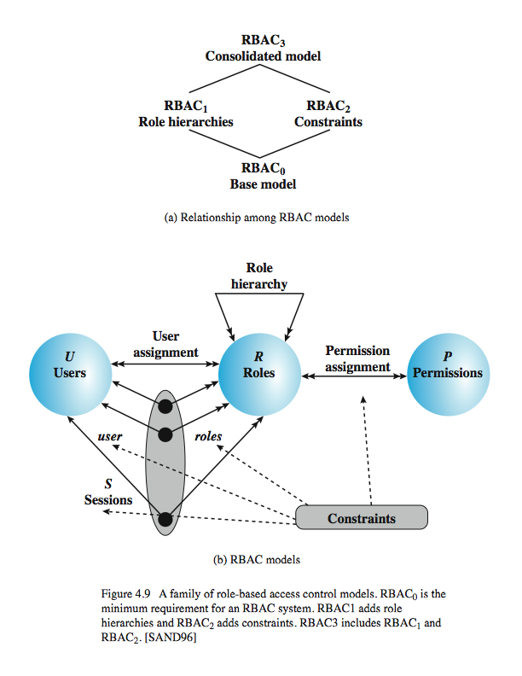
RBAC Reference Models
Base Model – RBAC0
Role Hierarchies – RBAC1
Constraints – RBAC2

Slide 26
Base Model-RBAC0
Notes:
A variety of functions and services can be included under the general RBAC
approach. To clarify the various aspects of RBAC, it is useful to define a set of
abstract models of RBAC functionality.
The solid lines in Figure 4.9b indicate relationships, or mappings, with a single
arrowhead indicating one and a double arrowhead indicating many. Thus, there is
a many-to-many relationship between users and roles: One user may have multiple
roles, and multiple users may be assigned to a single role. Similarly, there is a many-to-
many relationship between roles and permissions. A session is used to define a
temporary one-to-many relationship between a user and one or more of the roles to
which the user has been assigned. The user establishes a session with only the roles
needed for a particular task; this is an example of the concept of least privilege.
The many-to-many relationships between users and roles and between roles
and permissions provide a flexibility and granularity of assignment not found in
conventional DAC schemes. Without this flexibility and granularity, there is a greater
risk that a user may be granted more access to resources than is needed because of
the limited control over the types of access that can be allowed. The NIST RBAC
document gives the following examples: Users may need to list directories and modify
existing files without creating new files, or they may need to append records to a file
without modifying existing records.

Slide 27
Base Model-RBAC0
User:
An individual that has access to this computer system. Each individual has an associated user ID.
Role:
A named job function within the organization that controls this computer
system. Typically, associated with each role is a description of the authority and
responsibility conferred on this role, and on any user who assumes this role.
Permission:
An approval of a particular mode of access to one or more objects.
Equivalent terms are access right ,privilege, and authorization.
Session:
A mapping between a user and an activated subset of the set of roles
to which the user is assigned.
Notes:
A variety of functions and services can be included under the general RBAC
approach. To clarify the various aspects of RBAC, it is useful to define a set of
abstract models of RBAC functionality.
The solid lines in Figure 4.9b indicate relationships, or mappings, with a single
arrowhead indicating one and a double arrowhead indicating many. Thus, there is
a many-to-many relationship between users and roles: One user may have multiple
roles, and multiple users may be assigned to a single role. Similarly, there is a many-to-
many relationship between roles and permissions. A session is used to define a
temporary one-to-many relationship between a user and one or more of the roles to
which the user has been assigned. The user establishes a session with only the roles
needed for a particular task; this is an example of the concept of least privilege.
The many-to-many relationships between users and roles and between roles
and permissions provide a flexibility and granularity of assignment not found in
conventional DAC schemes. Without this flexibility and granularity, there is a greater
risk that a user may be granted more access to resources than is needed because of
the limited control over the types of access that can be allowed. The NIST RBAC
document gives the following examples: Users may need to list directories and modify
existing files without creating new files, or they may need to append records to a file
without modifying existing records.

Slide 28
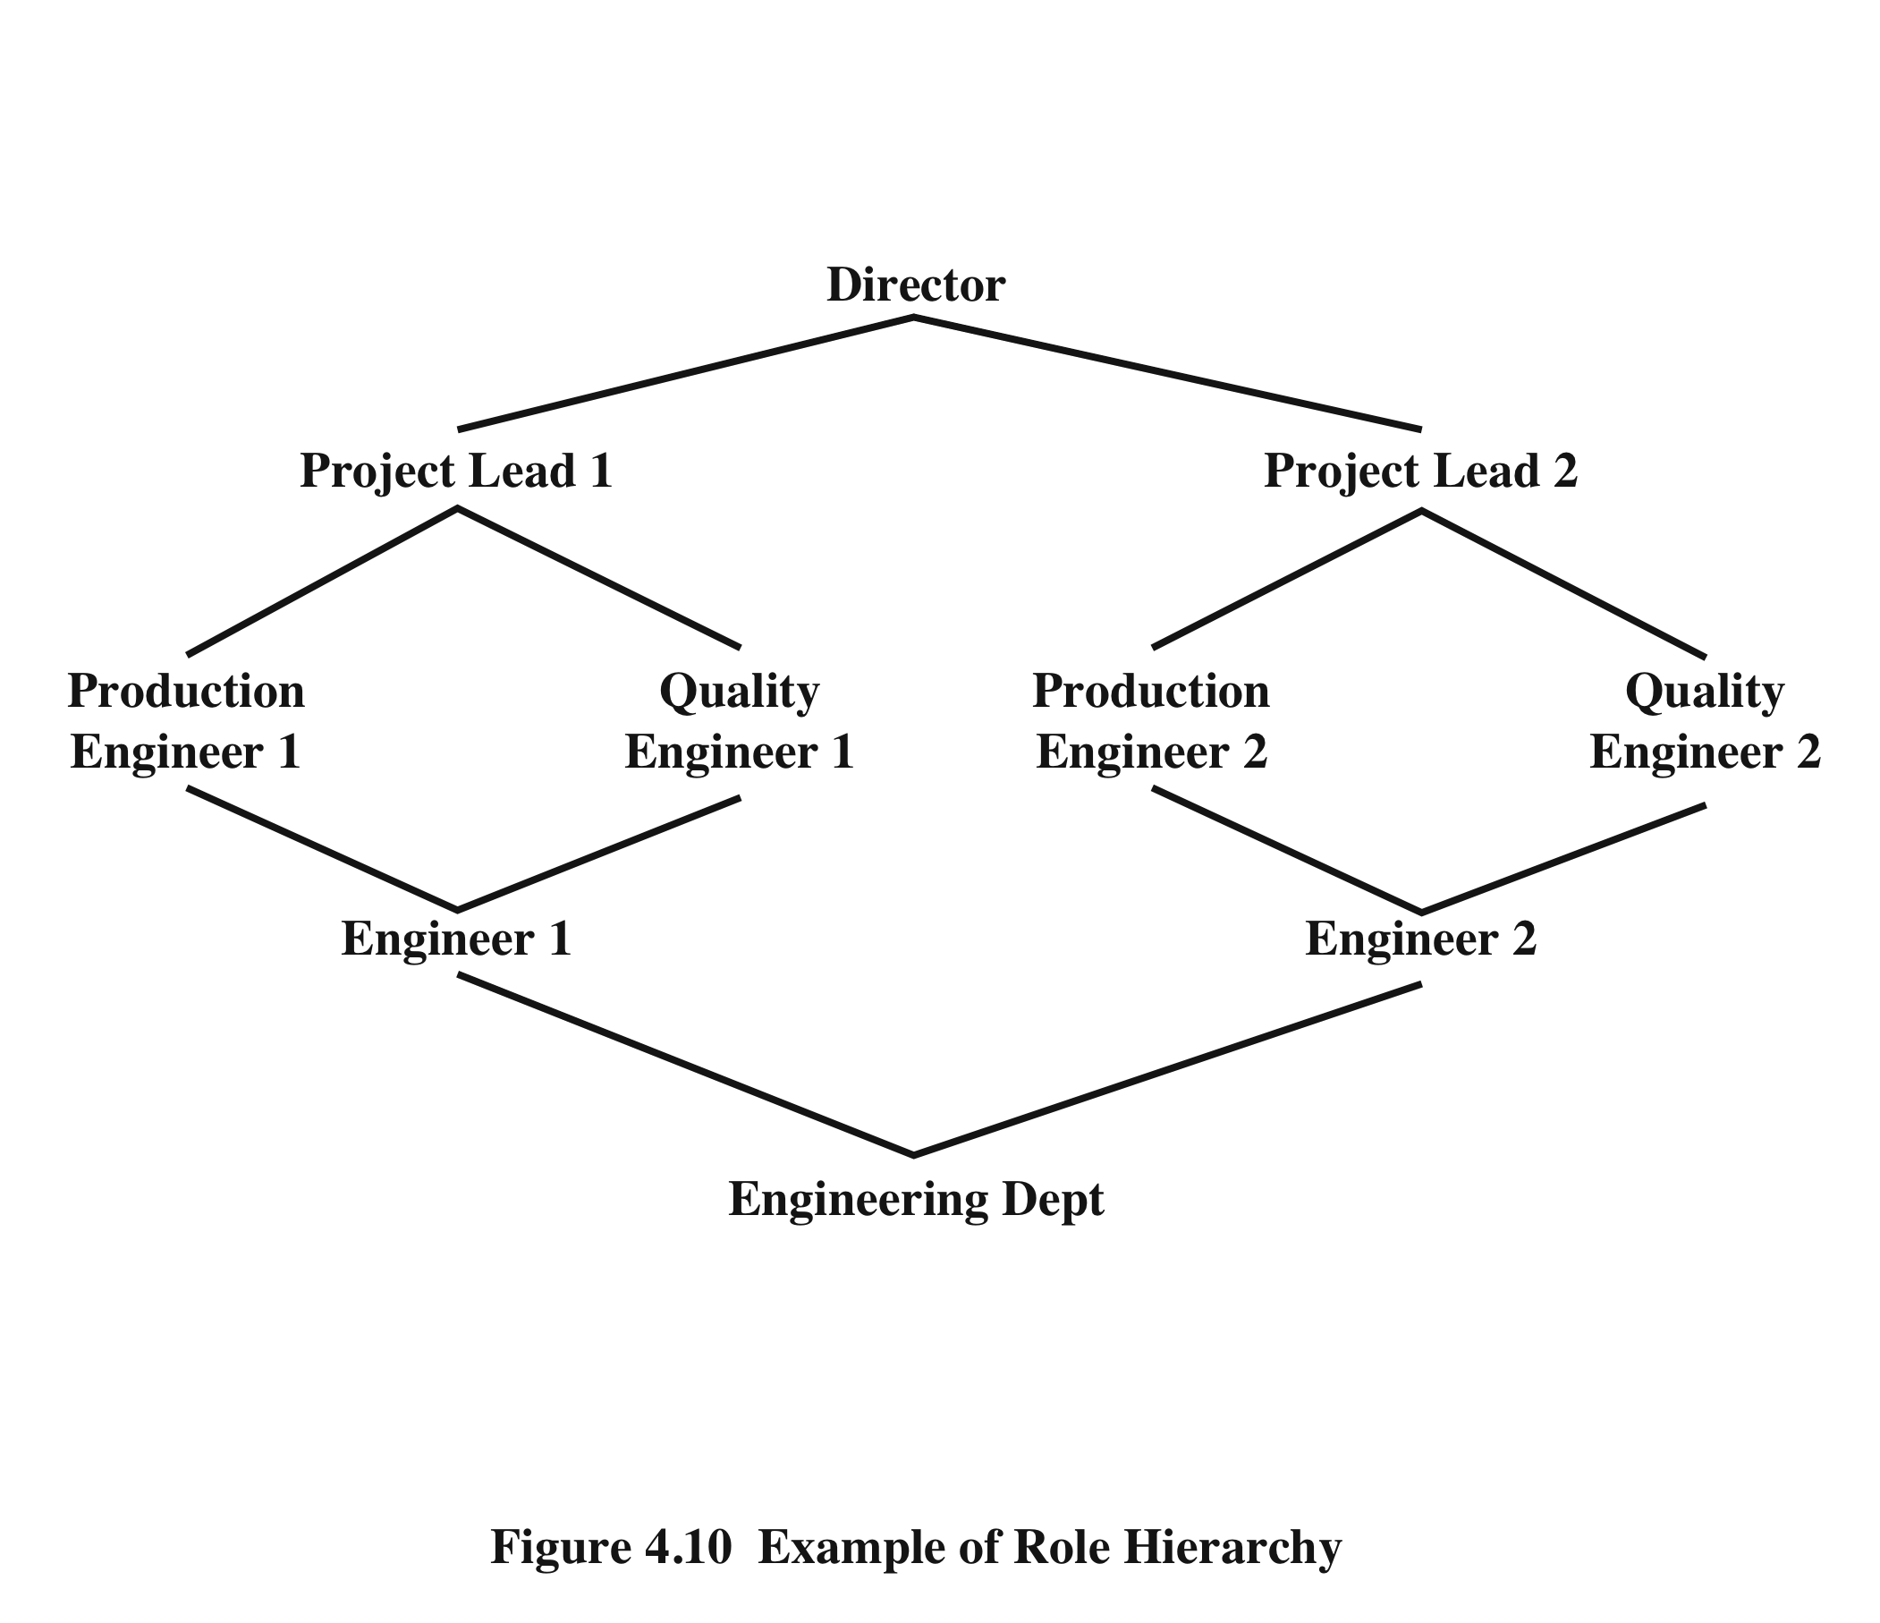
Role Hierarchies-RBAC1
Notes:
Role hierarchies provide a means of reflecting
the hierarchical structure of roles in an organization. Typically, job functions with
greater responsibility have greater authority to access resources. A subordinate job
function may have a subset of the access rights of the superior job function. Role
hierarchies make use of the concept of inheritance to enable one role to implicitly
include access rights associated with a subordinate role.
Figure 4.10 is an example of a diagram of a role hierarchy. By convention, subordinate
roles are lower in the diagram. A line between two roles implies that the
upper role includes all of the access rights of the lower role, as well as other access
rights not available to the lower role. One role can inherit access rights from multiple
subordinate roles. For example, in Figure 4.10, the Project Lead role includes all of
the access rights of the Production Engineer role and of the Quality Engineer role.
More than one role can inherit from the same subordinate role. For example, both
the Production Engineer role and the Quality Engineer role include all of the access
rights of the Engineer role. Additional access rights are also assigned to the Production
Engineer Role and a different set of additional access rights are assigned to the
Quality Engineer role. Thus, these two roles have overlapping access rights, namely
the access rights they share with the Engineer role.

Slide 29
Constraints – RBAC2
provide a means of adapting RBAC to the specifics of administrative and security policies of an organization
a defined relationship among roles or a condition related to roles
mutually exclusive roles
cardinality
prerequisite roles
a user can only be assigned to one role in the set (during a session or statically)
any permission can be granted to only one role in the set
setting a maximum number with respect to roles
dictates that a user can only be assigned to a particular role if it is already assigned to some other specified role
Notes:
Constraints provide a means of adapting RBAC to the
specifics of administrative and security policies in an organization. A constraint is
a defined relationship among roles or a condition related to roles. [SAND96] lists
the following types of constraints: mutually exclusive roles, cardinality, and prerequisite
roles.
Mutually exclusive roles are roles such that a user can be assigned to only
one role in the set. This limitation could be a static one, or it could be dynamic, in
the sense that a user could be assigned only one of the roles in the set for a session.
The mutually exclusive constraint supports a separation of duties and capabilities
within an organization. This separation can be reinforced or enhanced by use of
mutually exclusive permission assignments. With this additional constraint, a mutually
exclusive set of roles has the following properties:
1. A user can only be assigned to one role in the set (either during a session or
statically).
2. Any permission (access right) can be granted to only one role in the set.
Thus the set of mutually exclusive roles have non-overlapping permissions. If two
users are assigned to different roles in the set, then the users have non-overlapping
permissions while assuming those roles. The purpose of mutually exclusive roles is to
increase the difficulty of collusion among individuals of different skills or divergent job
functions to thwart security policies.
Cardinality refers to setting a maximum number with respect to roles. One
such constraint is to set a maximum number of users that can be assigned to a given
role. For example, a project leader role or a department head role might be limited
to a single user. The system could also impose a constraint on the number of roles
that a user is assigned to, or the number of roles a user can activate for a single session.
Another form of constraint is to set a maximum number of roles that can be
granted a particular permission; this might be a desirable risk mitigation technique
for a sensitive or powerful permission.
A system might be able to specify a prerequisite, which dictates that a user can
only be assigned to a particular role if it is already assigned to some other specified
role. A prerequisite can be used to structure the implementation of the least privilege
concept. In a hierarchy, it might be required that a user can be assigned to a senior
(higher) role only if it is already assigned an immediately junior (lower) role. For
example, in Figure 4.10 a user assigned to a Project Lead role must also be assigned
to the subordinate Production Engineer and Quality Engineer roles. Then, if the user
does not need all of the permissions of the Project Lead role for a given task, the user
can invoke a session using only the required subordinate role. Note that the use of
prerequisites tied to the concept of hierarchy requires the RBAC3 model.

Slide 30
Constraints – RBAC2
User
Instance
Task constraints – Least Privilege
Users are not given more permission than is necessary to perform their duties
Constraints
Achieved through task instances
Tasks
Permissions
status
Initiated
Alice
Check Patient Josh
Access Permissions starts when the instance is initiated
Active
Access Permissions end when the instance is completed or revoked
Fine Grained Access Control
Completed
Revoked
Notes:
Least Privilege
Users are given permissions selectively such that they are not given more permission than is necessary to perform their duties.
Prevents the issue of the user to perform unnecessary and potentially harmful actions.
Achieved through task instances
Access permission starts when the task is initiated and the access control permissions are revoked when the task is completed.
Task instance is created for each user and the user gets to see only certain information.
Fine grained access control.

Slide 31
Spatial and Temporal Constraints
Accessed from anywhere and at anytime
User’s location and time is taken into consideration for granting access to a task
Family Practice
Location Constraint (Reno Office)
Physician
Tasks
Time Constraint (8 - 5)
Nurse

Slide 32
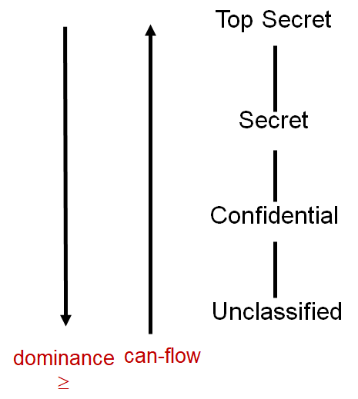
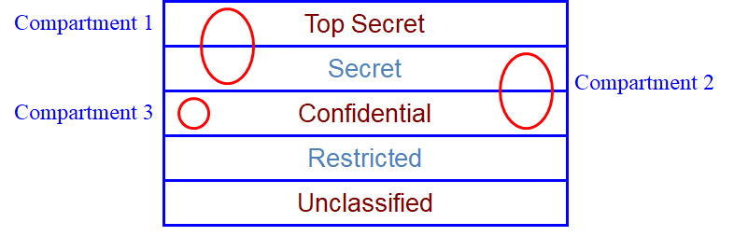
Mandatory Access Control (MAC)
Accessed from anywhere and at anytime
User’s location and time is taken into consideration for granting access to a task

Slide 33
Mandatory Access Control (MAC)
Information classified as <secret; {Sweden}>
Which of the following subject clearances can read the above information?
<top secret; {Sweden}>
<secret; {Sweden, crypto}>
<top secret; {crypto}>
<confidential; {Sweden}>
<secret; {France}>

Slide 34
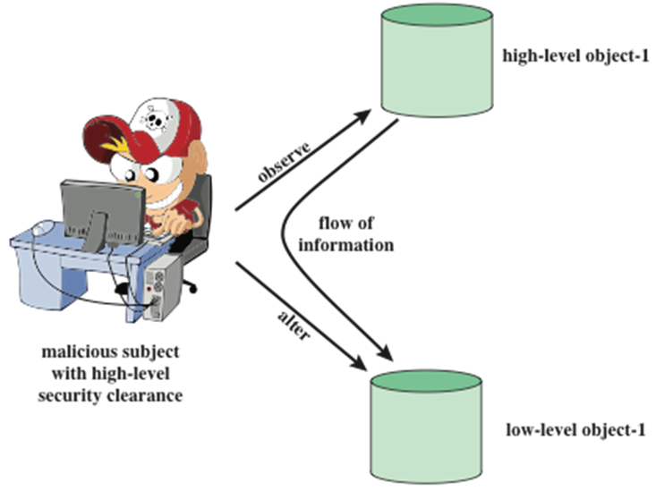
Attacking MAC
Here, a malicious subject, passes classified information along by putting it into an information container labeled at a lower security classification than the information itself.

Slide 35
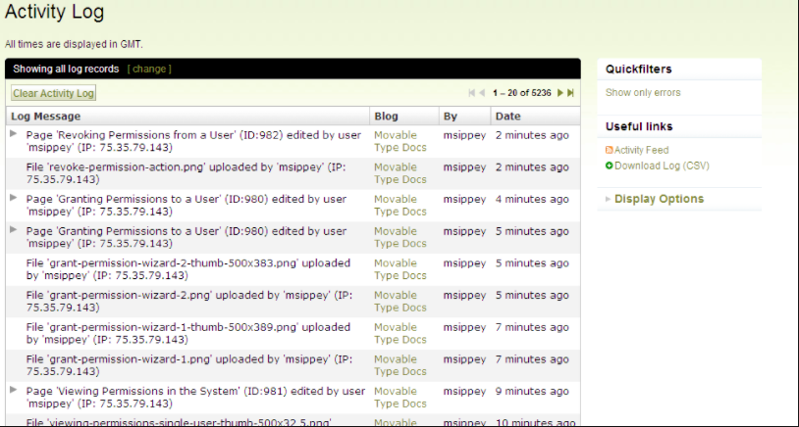
Accounting
Accountability traces an action back to a person or process making the change to a system, collects this information, and reports the usage data

Slide 36
Homework
Collect 30 Passwords of your friends, comment on each password and tell what vulnerability of each one. As a help fill the following table.
Friend’s name | Password | comment | Vulnerability
Ahmed Marzoq | ahmed1990 | Used his own name and year of birth | Easy to guess by simple dictionary attack
Notes:
Chapter 3 summary.

